Slide 1
AI APPLICATION PROJECT
by
Odochi Ihuoma Okezie(4342226)
Emmanuel David (4368025) Kiran Ravi(4372811)
Devesh Deepak Srewal(4364337)

Slide 2
TABLE OF CONTENTS
01
02
03
INTRODUCTION
DATA PRE-PROCESSING
MODEL DEVELOPMENT
04
05
06
MODEL EVALUATION
CONCLUSION
DEPLOYMENT AND FUTURE WORK

Slide 3
INTRODUCTION
Objective: Utilize machine learning to forecast housing prices using diverse features encompassing property attributes, locality, market trends, and environmental factors.
Goal: Identify and understand the influential factors shaping housing prices to assist investors, real estate professionals, and potential buyers or sellers.
Impact: Provide critical insights into the housing market, facilitating informed decisions in real estate transactions.

Slide 4
Data Importation and Structure:
The dataset, containing housing-related features, was loaded into a pandas DataFrame.
Quick overview with .info() method: 509 entries, 14 columns, data types include float64 and int64.
Statistical Summary:
Utilized .describe() method to provide a statistical summary of the DataFrame.
Summary includes count, mean, standard deviation, min, 25th percentile, median (50th percentile), 75th percentile, and max values for each feature.

Slide 5
Feature Highlight:
The dataset consists of both continuous and categorical variables.
Features range from crime rates (CRIM) to environmental factors like nitric oxides concentration (NOX), and socioeconomic status (LSTAT).
The target variable is the median value of owner-occupied homes (MEDV)
Initial Observations:
• No missing values detected in the dataset.
• Provides a solid foundation for the application of machine learning techniques for price prediction.

Slide 6
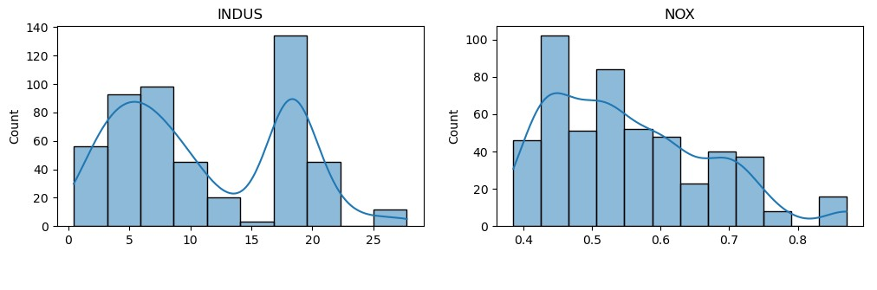
DATA PRE-PROCESSING : UNDERSTANDING FEATURE DISTRIBUTIONS

Slide 7
DATA PRE-PROCESSING : UNDERSTANDING FEATURE DISTRIBUTIONS
INDUS: Proportion of Non-Retail Business Acres Per Town
The histogram shows a bimodal distribution, indicating two peaks where such business acres are most common.
There are significant concentrations around 18 and another around 6, suggesting areas with distinctly high or low non-retail business activity.
NOX: Nitric Oxides Concentration
This histogram displays a skewed distribution, leaning towards lower NOX concentrations but with a long tail to the right.
Most areas have relatively low nitric oxide pollution, with a few areas experiencing higher levels, which may influence property values.

Slide 8
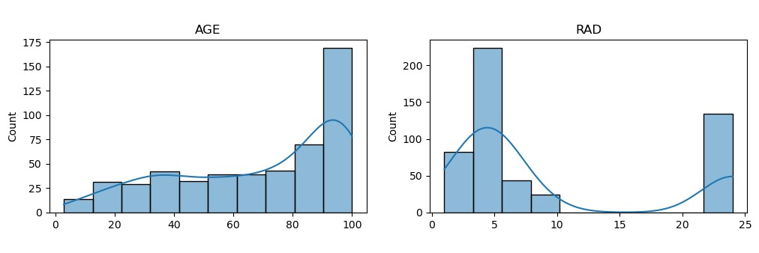
DATA PRE-PROCESSING : UNDERSTANDING FEATURE DISTRIBUTIONS

Slide 9
DATA PRE-PROCESSING : UNDERSTANDING FEATURE DISTRIBUTIONS
AGE: Proportion of Owner-Occupied Units Built Prior to 1940
The distribution is slightly skewed to the left, with a large number of towns having a high proportion of older houses.
There’s a noticeable decline in the proportion of towns with newer housing, indicating that much of the area consists of older buildings.
RAD: Index of Accessibility to Radial Highways
The histogram for RAD shows a non-uniform, multimodal distribution, indicating clusters of towns based on highway accessibility.
A significant spike can be observed at the highest index value, suggesting a subset of towns with very high access to radial highways. This could reflect on the real estate prices due to the ease of transportation.

Slide 10
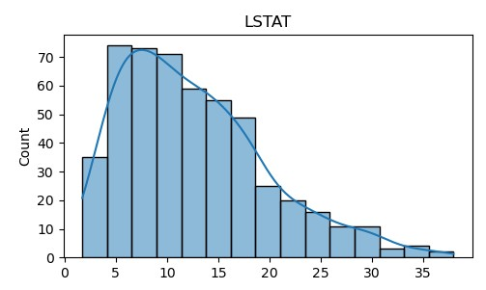
DATA PRE-PROCESSING : UNDERSTANDING FEATURE DISTRIBUTIONS

Slide 11
DATA PRE-PROCESSING : UNDERSTANDING FEATURE DISTRIBUTIONS
LSTAT: % Lower Status of the Population
LSTAT's histogram appears right-skewed, indicating that a majority of the towns have a lower percentage of the lower-status population.
There's a gradual increase in frequency from the lowest to a mid-point percentage followed by a sharp decline, suggesting fewer towns have a very high percentage of lower-status populations. This variable is typically inversely related to housing prices, with higher values potentially leading to lower house valuations.

Slide 12
Rationale for Median Imputation:
Median is less affected by outliers compared to the mean, making it a robust measure for skewed data.
Applied to 'INDUS', 'NOX', and 'AGE' due to their non-normal distribution, as indicated by their histograms.
Why Mode for 'RAD'?
'RAD' represents the accessibility index to radial highways, which is a discrete and multimodal feature.
The mode, being the most frequent value, preserves the most common category within this feature, ensuring the integrity of the data's categorical nature.

Slide 13
MODEL DEVELOPMENT STRATEGY FOR MODEL SELECTION
Linear Regression:
Chosen for its simplicity and interpretability.
Serves as a baseline to understand the linear relationship between features and target variable.
Random Forest Regression:
Selected for its robustness to outliers and ability to model non-linear relationships.
Handles complex interactions between features without extensive data preprocessing.
Assumptions:
Assumes that both models are suitable for the scale and nature of the housing dataset.
Preliminary analysis suggests that the data contains both linear and complex patterns.

Slide 14
MODEL EVALUATION
Linear Regression Results:
MAE: 2.98 - On average, the model’s predictions are approximately $2,980 off from the actual home values.
MSE: 20.46 - Indicates that the predictions are, on average, squared $20,460 away from the actual values; higher due to more significant errors.
RMSE: 4.52 - The model’s predictions deviate from the actual values by $4,520 on average, which gives a more realistic error magnitude due to the square root of MSE.
R²: 0.738 - The model explains 73.8% of the variance in housing prices, which is considered a decent level of fit for the model.

Slide 15
MODEL EVALUATION
Random Forest Regression Results:
MAE: 1.98 - Indicates a more accurate model with an average prediction deviation of $1,980.
MSE: 8.43 - A lower value here reflects fewer amplified errors in prediction.
RMSE: 2.90 - Signifies that, on average, predictions are $2,900 away from the actual value, highlighting a better prediction accuracy.
R²: 0.892 - Shows that 89.2% of the variance in housing prices is explained by the Random Forest model, indicating a strong fit.
Model Comparison:
The Random Forest model outperforms the Linear Regression model across all metrics.
The significant improvement in both RMSE and R² metrics for the Random Forest model suggests it is more adept at capturing the complex patterns in the data and making more accurate predictions for housing prices.

Slide 16
SUMMARY
Key Findings:
The R² value of 0.892 for the Random Forest model suggests that 89.2% of the variance in housing prices can be predicted from the features provided, showcasing the power of advanced ensemble methods in complex predictive tasks.
Strategic Value:
This analysis has surfaced key factors influencing housing prices, providing actionable insights for stakeholders in the real estate market.
Forward Look:
With the effective model identified, the next steps involve deploying it as a decision-support tool, potentially extending our dataset, refining feature engineering, and exploring even more sophisticated modeling approaches such as neural networks.

Slide 17
REFERENCES
Brownlee, J. (2016). Machine Learning Mastery With Python: Understand Your Data, Create Accurate Models and Work Projects End-to-End. Machine Learning Mastery.
Géron, A. (2019). Hands-on machine learning with Scikit-Learn, Keras, and TensorFlow: Concepts, tools, and techniques to build intelligent systems (2nd ed.). O'Reilly Media.
Raschka, S., & Mirjalili, V. (2017). Python machine learning. Packt Publishing.
Pedregosa, F., Varoquaux, G., Gramfort, A., Michel, V., Thirion, B., Grisel, O., ... & Dubourg, V. (2011). Scikit-learn: Machine learning in Python. Journal of Machine Learning Research, 12, 2825-2830.
“Linear Regression for Machine Learning.” (n.d.). Machine Learning Mastery. Retrieved from https://machinelearningmastery.com/linear-regression-for-machine-learning/
“Random Forests Regressor Example.” (n.d.). Scikit-Learn. Retrieved from https://scikit-learn.org/stable/auto_examples/ensemble/plot_forest_regression.html
TensorFlow Team. (n.d.). TensorFlow Documentation: Overfitting and Underfitting. Retrieved from https://www.tensorflow.org/tutorials/keras/overfit_and_underfit

Slide 18
EMMANUEL’S GITHUB LINK
https://github.com/egobaba/AI_data

